Slide 1
Residential Flame Rectification
HSI Simulator Presentation

Slide 2
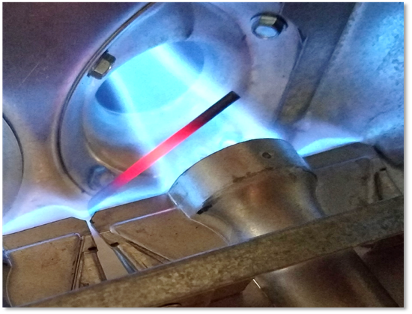
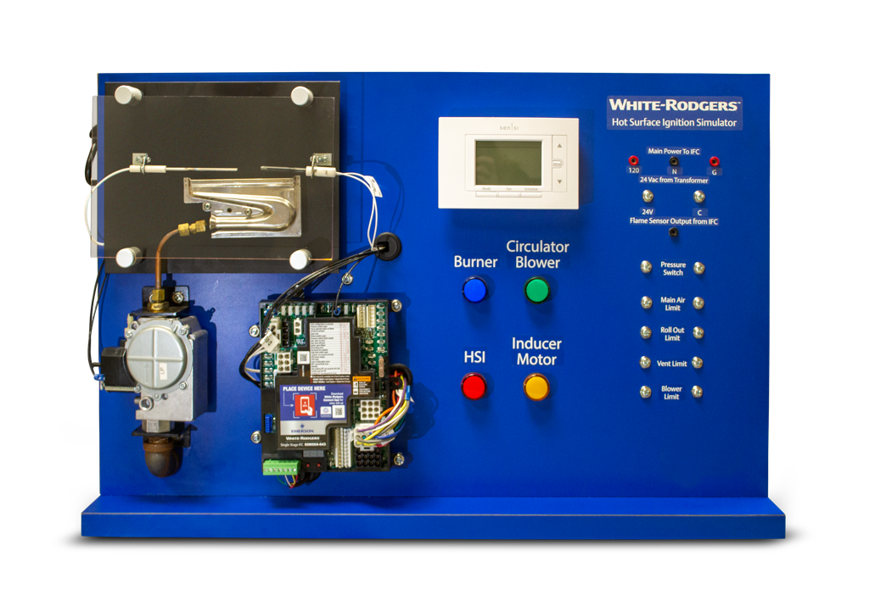
Course Agenda
Section One– Flame Rectification | What is Flame Rectification Why is Flame Rectification Necessary Where is Flame Rectification Found When is Flame Rectification Observed How is Flame Rectification Achieved
Section Two– Troubleshooting the Flame Rectification Circuit | The Furnace Board (IFC) The Flame Sensor/Rod The Flame The Furnace The Ground Circuit
Notes:
This Course has a Two Section Agenda
Flame Rectification Basics
What is it? - Basically it’s a long electrical circuit consisting of: Source, Path, Load
Why do we use it? – Safety, it’s very accurate for a number of reasons
Where does it happen? – It happens in the flame from the burner to the flame sensor
When does it happen? – Must have a heat call, flame present and flame must envelop the flame sensor/rod and not lift off of the burner face – the flame is part of the path and it also the load
How does it happen? – AC or alternating current is converted or rectified to DC or direct current because of the high resistance of the flame and that the surface area of the burner is much greater than the surface area of the flame sensor/rod; it is easier for current to flow from a small surface area to a large surface area but the current is greatly reduced when the direction is reversed
Troubleshooting Flame Rectification – Again – Source, Path, Load
Power at IFC (power in/power out) Source
Power to IFC
Power from IFC
Power to flame sensor/rod Path
Wire
Broken
Pinched
Sensor/Rod
Cracked ceramic holder
Touching metal (burner or other)
Dirty/Corrosion
Flame disturbance (flame is not enveloping the sensor/rod) Path and Load
Gas pressure – too high (blowing past rod)/too low (wavering)
Valve
Regulator
Orifice – malformed flame patterns – flame not centered in the heat exchanger inlet tube
Restriction behind
Restriction in front
Damaged
Burners – malformed flame patterns – flame not centered in the heat exchanger inlet tube
Restricted
Corrosion
Alignment
Heat Exchanger - malformed flame patterns – flame not centered in the heat exchanger inlet tube
Restricted
Breached/cracked
Flue - malformed flame patterns – flame not centered in the heat exchanger inlet tube
Restricted
Combustion motor assembly – motor or wheel
Wheel damage
Motor speed
Furnace metal/Ground wires - Path
Burner corrosion
Burner bracket loose
Screws that fasten the burner assembly – loose/corroded
Wiring – broken/pinched
Furnace on dedicated circuit/connected with extension cord – must be uninterrupted circuit
Earth ground at breaker/fuse panel.
Exterior earth ground at home – actual rod driven into the ground – is the ground dry? Non-conductive?
NOTE: The burners in both pictures are different types: the HSI simulator has an older style ribbon burner and the bottom right-hand picture is the more modern in-shot burner. Both have been used with flame rectification in the residential HVAC industry
NOTE: The quality of the flames in the top right-hand picture:
The cross-over flames (the lesser protruding flame in between the larger flames entering the heat exchanger tubes) are not lifting (providing excess heat in the burner area), they are not low and wavering, they are substantial enough to provide the lighting of the burner next to them (that is their purpose)
The burner flames (the greater flame that is not fully seen because it is entering into the heat exchanger tube) is strong, is not wavering, nor is it impinging (hitting the side of the inlet to the heat exchanger before entering

Slide 3
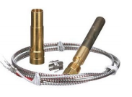
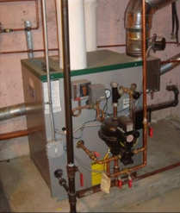
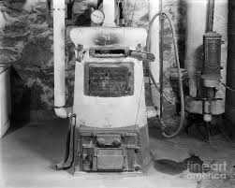
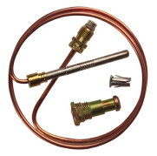
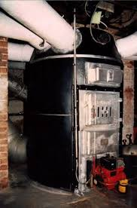
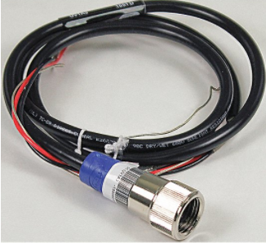
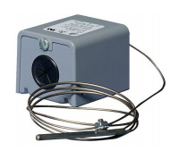
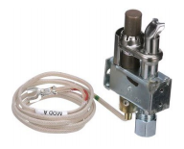
Residential Flame Detection/Proving
Visual
IR
UV
Electro-Mechanical
Heat reactive switches
Electrical
Thermocouple/ Thermopile
Flame Rectification
Notes:
Over the recent history of residential heating, whether it be:
Hydronic (sometimes called “Wet” heating because it uses hot water or steam to heat residential homes). Note the upper middle & right-hand pictures of boilers that heat water
Warm-Air (generally known as “Forced-Air” furnace or “Warm-Air” furnace). Note the bottom center picture of an oil-fired warm-air furnace.
Whether the fuel source is Oil (note the lower picture), Coal (note the upper right-hand picture) or Gas (note the upper-middle picture)
There has always been a need for safety. Which means detecting or proving that the fuel that enters the equipment is burning or combusting and not just entering the home – which could cause catastrophic damage to life and property.
There have been many ways of flame detection or proving that a flame is present:
Visual
Infrared detection (note picture in lower right-hand corner)
Ultra-violet (basically the same picture)
Electro-Mechanical
Heat reactive switches (note the picture of such a switch in the lower left-hand corner – currently offered by White Rodgers). The sensing bulb would be in the flame and the liquid or gas with the bulb and tube would expand to make or break a switch within the box
Electrical
Thermocouple/Thermopile (note the three pictures in the center from top to bottom: Thermopile, thermocouple, thermocouple in a pilot assembly – all still offered by White Rodgers). Heat makes two dis-similar metals generate a small amount of electricity
Flame rectification – This is the current and most popular means of flame proving in modern residential gas fired furnaces and the focus of the today’s interactive presentation – next slide

Slide 4
Flame Rectification
Section one

Slide 5
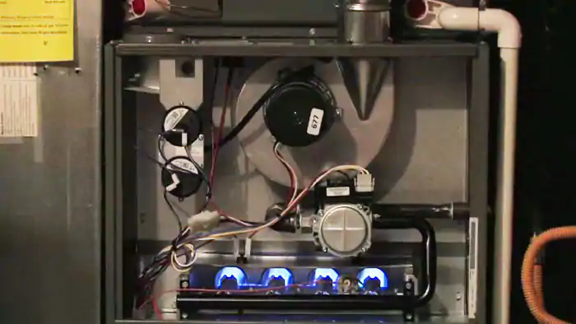
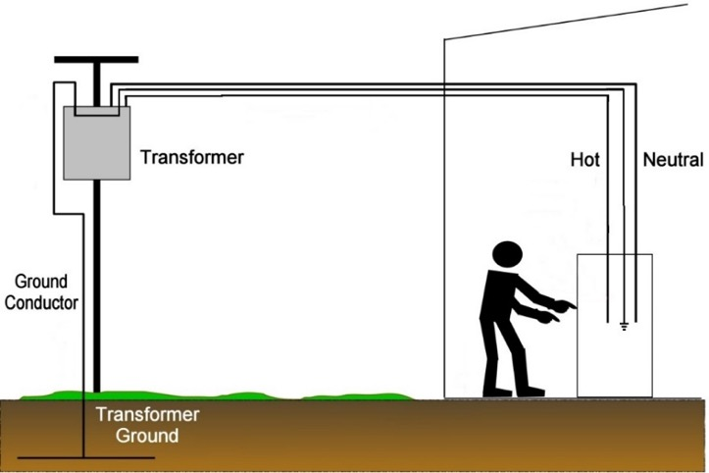
What is Flame Rectification
Flame rectification is the process of proving that a flame is present in order to continue to safely allow gas/fuel flow into a furnace for combustion.
Flame rectification is dependent on an electrical circuit made up of:
A residential furnace and its components
The flame as it comes from the burner and envelops the flame sensor or flame rod
The wiring from the furnace as well as the wiring from a building
Notes:
It’s critical that HVACR technicians know the basics of electricity and how it is transmitted (i.e. how electricity flows). Only when you know what should be happening normally can you fully start to understand an abnormal condition (we will cover that in section 2: troubleshooting the flame rectification circuit). Electrical and also Plumbing concepts are used by all HVACR technicians.
The top right picture is the residential warm-air furnace, where the Source, Load and the first section of the Path are located:
The Source of the electricity is ultimately where it is generated (usually a power plant/the electric company). For our purposes the source is the furnace PC board or IFC (Integrated Furnace Control)
The Path of the electricity flows from the IFC through a wire that is connected to the flame sensor, or flame rod (A metal rod with a section encased in ceramic). NOTE of WARNING: if the furnace has power, no matter if it is running, there is always electricity present of the flame sensor/rod. CAUTION: Always turn off power to the furnace when attempting to handle the flame sensor/rod.
The Load is the flame. Should only be present when there is a call for heat from the thermostat. NOTE: The flame must envelope the flame sensor/rod for the path to be complete. NOTE: A low volume of flame or wavering flame is a sign of an abnormal condition or a condition that is worsening.
The bottom right picture is the full “Path” for the electricity from the furnace burner to earth ground:
The metal burners are secured to a metal bracket by screws
The bracket is secured to the furnace wall (metal) by screws.
The furnace wall is connected to the furnace cabinet by screws
There should be a ground wire that is secured to the furnace cabinet by a screw.
The ground wire of the furnace should connect to a wire that travels uninterrupted to the breaker/fuse panel of a residential house
The ground/neutral bar of the breaker/fuse panel should go to earth ground
In very arid (low water table, dry climates) areas with a ground rod driven into the earth, – it may even be necessary to soak the ground with water to promote a good/suitable earth ground

Slide 6
Put It Into Practice – Checking the Source
Without a call for heat, measure the voltage output of the IFC or furnace board at the terminal on the HSI Simulator labeled:
“Flame Sensor Output From IFC”
to either terminal labeled:
“N” or “G”
What is the reading?
Notes:
With the HSI Simulator Powered but No Call For Heat
Check Voltage of the “Flame Sensor Output From IFC” Terminal to Ground “G” Terminal
Or
Check Voltage of the “Flame Sensor Output From IFC” Terminal to Neutral “N” terminal
Should read about 40 VAC

Slide 7
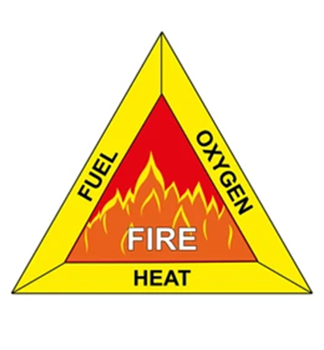
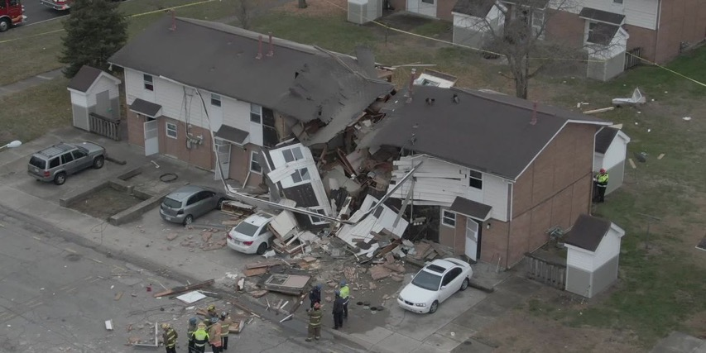
Why is Flame Rectification Necessary?
Flame Rectification is necessary for safety.
If there were no flame proving, the gas valve would continue to allow fuel to flow, most likely without combusting.
Built up gas inside of a structure is an extremely unsafe situation.
In the presence of heat (even a spark) and oxygen, there could be an explosion.
Notes:
SAFETY, SAFETY, SAFETY!!!
Houses blowing up are in the news EVERY YEAR
Gas leaks can happen not only within the furnace
With FLAME RECTIFICATION, safely operating a furnace has increased dramatically

Slide 8
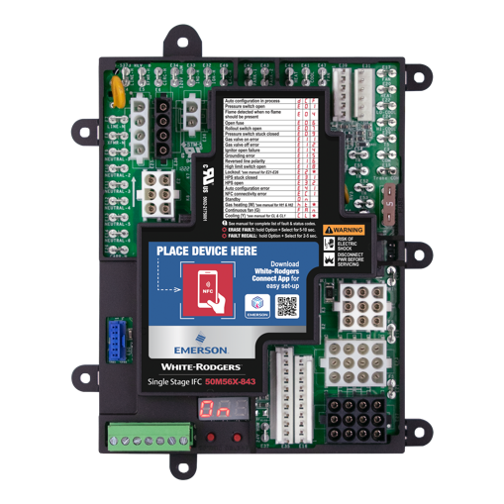
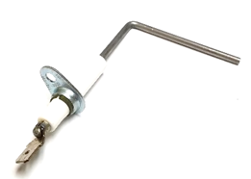
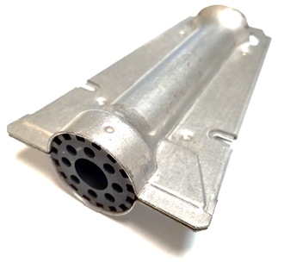
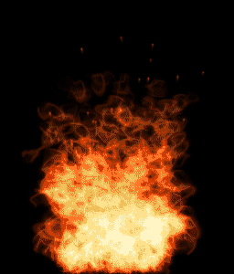
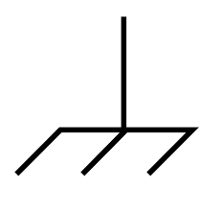
Where is Flame Rectification Found?
The flame from the burner acts as both a switch and a load, remember the basic electrical circuit; this is where rectification occurs.
The flame rod always has AC voltage present, it is connected to the furnace board.
Because the flame rod surface area is so much smaller than the burner surface area and the high resistance of the flame, the returning current to the furnace board is not AC but DC
Notes:
The output voltage of the IFC is AC (Alternating Current); it attempts to travel all the way to earth ground. Therefore the path must be uninterrupted (follow the path in the pictures – SOURCE (IFC) – PATH (wire to rod & rod/sensor) – LOAD/PATH (flame) – PATH (burner, metal in furnace to equipment ground then wires to earth ground)
The current travels through the flame (very high resistance) from a very small surface area (the flame sensor/rod) very easily to a very large surface area (the burner surface)
AC wants to return (it alternates) to the source but when it returns to the IFC – through the flame from a large surface area (the burner face) to a very small surface area (the flame sensor/rod) it is converted from AC to DC (direct current)

Slide 9
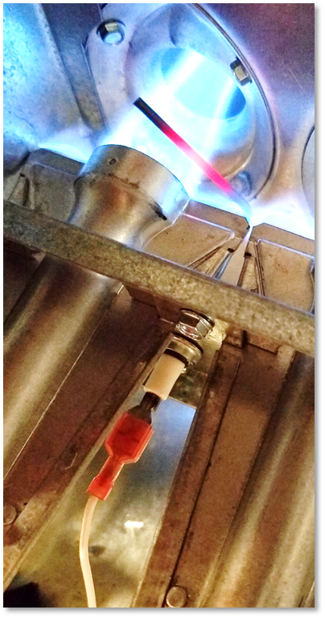
When is Flame Rectification Observed?
Whenever the flame from the burner is present and in good contact with both the burner and the flame sensor/rod, flame rectification should occur.
The AC output from the furnace board must be proper with no leakage to ground.
There can be no excessive corrosion on any metal surfaces that make up the electrical circuit.
The circuit must be continuous and uninterrupted.
Notes:
There must be a call for heat
Burners must light off – good flame (not too strong – lifting), not too weak (wavering). Look at this flame and note all of the good characteristics:
Not too strong – blowing past flame sensor/rod, impinging against the sides of the inlet of the heat exchanger tube
Not too weak – Not wavering around
The flame THOROUGHLY ENVELOPS/SURROUNDS the flame sensor/rod from the face of the burner
Flame connects the burner face to the flame sensor
All other sections of the path must be well connected and free of corrosion

Slide 10
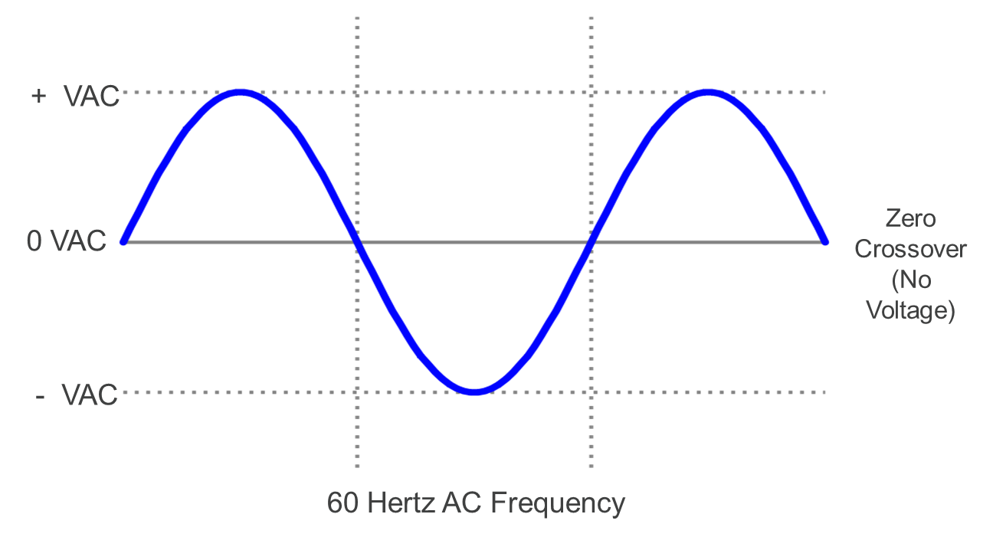
How is Rectification Achieved?
The source voltage for a standard residential furnace is approximately 120 VAC or Volts Alternating Current
Alternating current, means the voltage changes polarity and the flow of electrons changes direction
In North America, this change occurs very quickly - 60 times every second (60 Hertz, Hz)
Notes:
Jumping back to the basics of AC electricity to help understand rectification
Source of electricity in a residential home is AC Alternating Current – a flow of electrons that quickly changes directions and can be measured

Slide 11
How is Rectification Achieved?
Rectification is the electrical process of converting alternating current (AC), which repeatedly reverses direction, to direct current (DC), which flows in only one direction. In the electrical example below:
AC passes through a bridge rectifier
Diodes only allow the current to flow in one direction
Resulting in half of the electrical signal, but all flowing in the same direction
Notes:
Basics of electrical rectification and how one would build (what components are in) a bridge rectifier.

Slide 12
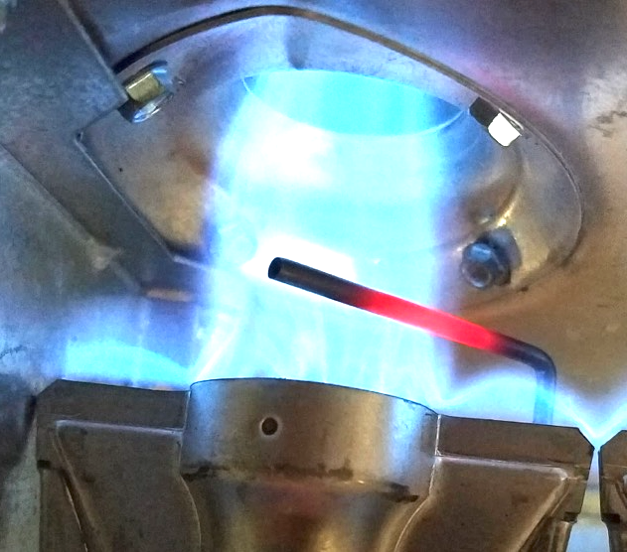
How is Flame Rectification Achieved?
The flame sensing circuit is designed to function like a bridge rectifier
Flames have very high resistance, making it difficult for current to flow through them
The size of the conductor affects the rate of current flow through a circuit
The size of each conductor on opposite sides of the flame will affect the rate of electron flow through the flame
Small surface area
Large surface area
Notes:
We see that rectification can be built artificially, but it happens naturally in a flame
The resistance of the flame is the 10-100 million ohm range—very high
When the high resistance of the flame is combined with the difference in the sizes between the flame rod and the burner, rectification naturally occurs

Slide 13
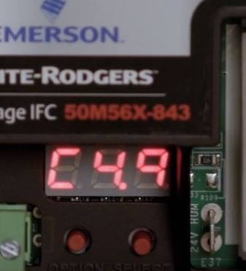
Put It Into Practice – Rectification: AC to DC
With a call for heat, note the reading on the display
What is the voltage reading?
Display is in uA DC.
Notes:
Operate the HSI Simulator (in either mode)
Check the flame signal on the two pins on the IFC in two positions:
Live Fire mode with flame present
OR
LED Only Mode when “Burner” LED is illuminated (make sure SW 14 is in “strong flame signal strength” position - UP
Should read 2-4 VDC which converts to 2-4 uA DC

Slide 14
Flame Rectification: Key Takeaways
In residential warm-air furnaces, flame rectification is the predominant industry method to prove that there is a flame present for combustion in order to operate safely.
If the IFC does not send out the proper AC current or detect the proper DC current on the flame sensing circuit, it shuts off the flow of gas quickly to prevent a possible catastrophe.
Flame rectification is an electrical circuit from the furnace PC/IFC board (source) all the way to earth ground (path) with the flame acting as both a switch and a load.
Flame rectification occurs in the highly resistive flame and because of the fact that the returning AC electrons are traveling from a large surface (burner) to a small surface (flame rod/sensor).
The flame must envelop the flame rod. The path must be uninterrupted and free of corrosion or any other resistance.
Notes:
Questions?

Slide 15
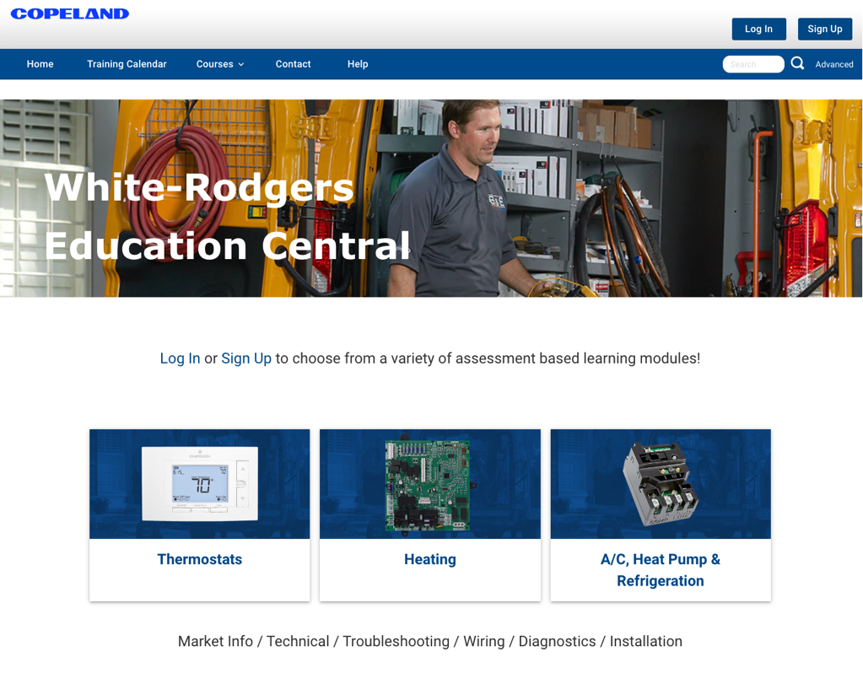
Key Takeaways
For more information on flame rectification circuits visit us on White Rodgers Education Central https://go.bluevolt.com/whiterodgers/

Slide 16
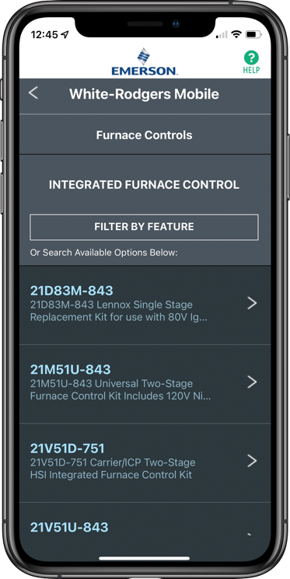
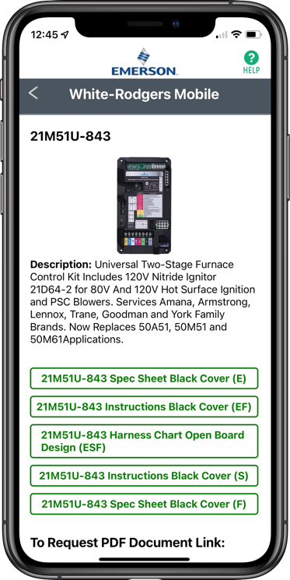
WR Mobile App
Scan the QR code to download from your app store.
Always up-to-date and easy to use
Search by OEM, competitive, or White-Rodgers model number
Try the desktop version at https://wrcrossref.com
Your resource for:
Product information and spec sheets
Complete Cross Reference
OEM compatibility
Installation information and videos
Wiring diagrams
Priority technical help
Search
Scrollable Product List
White-Rodgers Replacement

Slide 17
Troubleshooting the Flame Rectification Circuit
Section Two

Slide 18
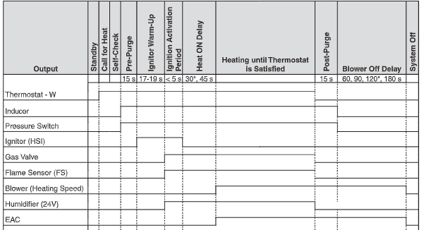
Heating Mode Sequence of Operation
Timings shown are typical of systems in the field, but specific applications may vary from these typical values.
Notes:
Here is the sequence of operation for the heating mode of this IFC (Taken from the installation instructions of the IFC) on the HSI simulator with the corresponding LED colors and flashes for all of the functions of the IFC. Although, this course is mainly focused on proving the flame (highlight the Flame Sensor period), if any of the steps necessary for flame generation in this Sequence of Operation fails, then flame proving is unnecessary.
Remember that there must be a flame for rectification
The LED is a tri-color light; it can glow green, red or amber (Point it out on the HSI simulator)

Slide 19
Put It Into Practice – Sequence of Operation
Notes:
Operate the HSI Simulator (in either mode)
Following The Sequence Of Operation Along The Way Through
Now that we know the basics of flame rectification and the sequence of operation, we’re ready to troubleshoot the flame rectification circuit

Slide 20
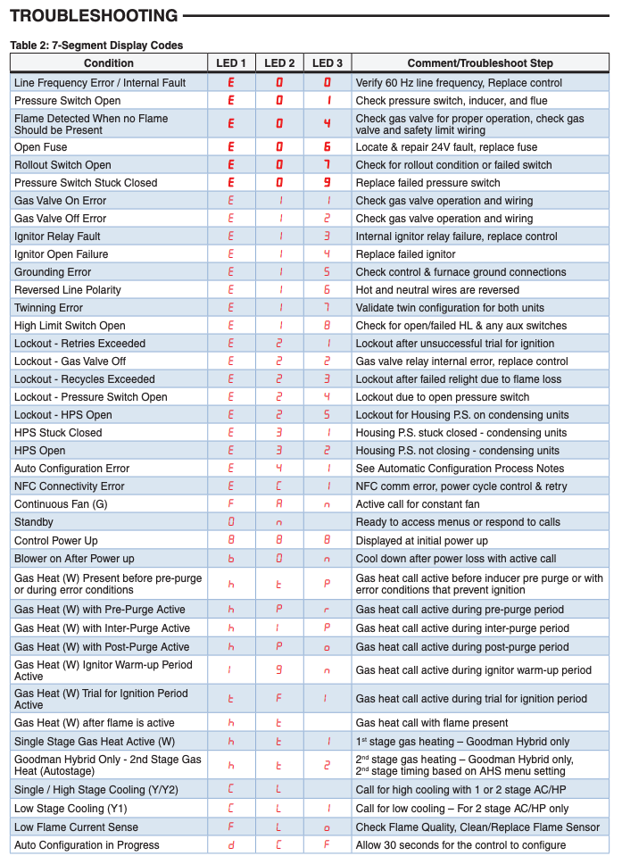
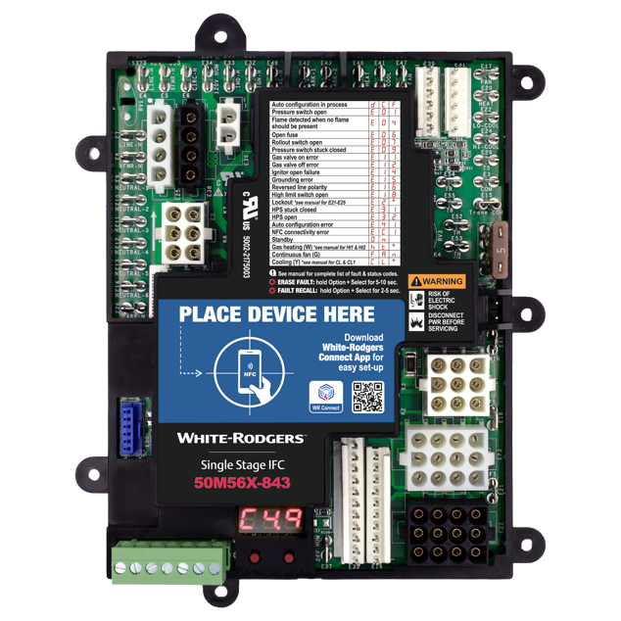
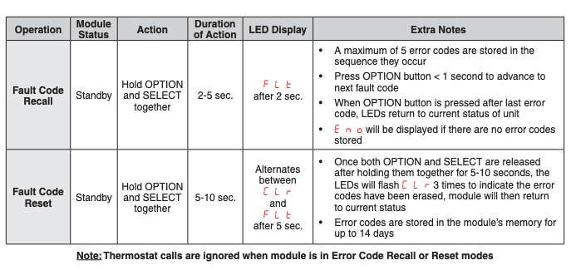
Troubleshooting the flame rectification circuit
The 50M56X-843 displays error codes on the digital display with guides on the product label as well as the instruction sheet.
For quick and easy diagnostics view error codes in the White-Rodgers Connect app which also displays troubleshooting tips.
Notes:
Now that we know the fundamentals of flame rectification and the sequence of operation for this IFC, we can begin discussing troubleshooting.
What you see here is the legend for the Fault and Status codes of the LED on the IFC. It is from the installation instructions for this universal replacement IFC and a version can be found on the IFC itself
We will only be concerned with the faults associated with flame rectification for this presentation. There are other presentations that cover other faults.
Most furnace boards/IFCs have diagnostics/fault/status lights/LEDs that lead to a particular problem in a safety circuit that the IFC is monitoring. There are three basic safety circuits that IFCs constantly monitors during a heating call:
The limit (high temperature sensing) circuit – If the furnace is overheating in a certain area, we want the furnace to shut down to prevent damage to the equipment or start a fire
The combustion (pressure switch) proving circuit – If the furnace can’t safely exhaust the products of combustion (some of which are harmful and deadly to human and animal life) out of the home it could cause injury or even death
The flame rectification circuit – Remember from the basics, if the furnace can’t prove that there’s a flame, we don’t want to allow the gas valve to remain open and fill the home with fuel

Slide 21
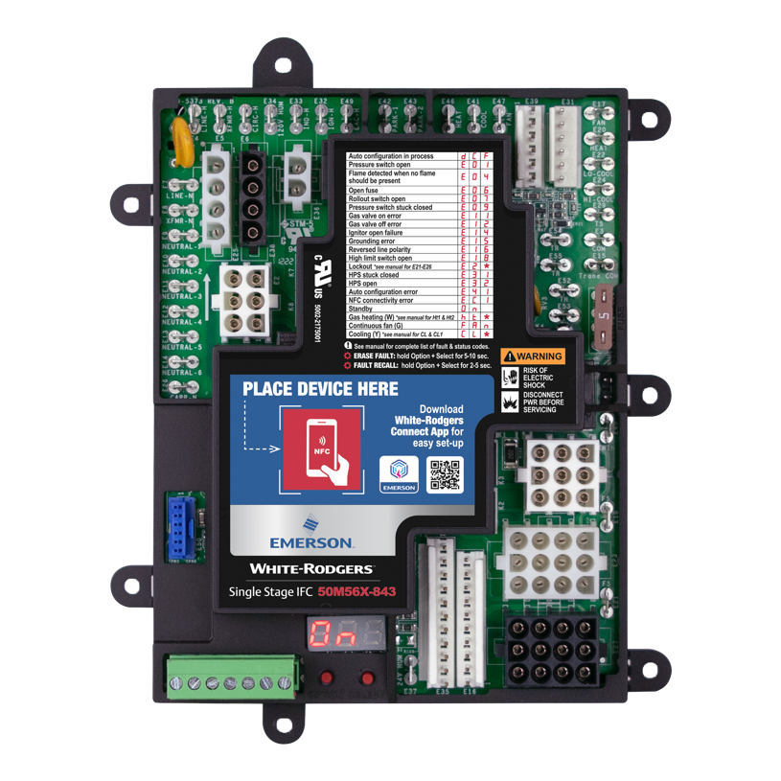
Troubleshooting – The Source
120VAC @ the Red Circles
24 VAC @ the Yellow Circle
Notes:
We will only be focusing on the Flame Rectification circuit in this presentation.
Just as we learned about the basics of the Flame Rectification Circuit when we took it down to a simple electrical circuit, we will break it down in order to learn about troubleshooting.
We will start at the SOURCE of the current .
Remember that we have to have voltage into the IFC for the IFC to work properly. Both 120VAC and 24VAC need to be present at the right places on the IFC. For safety, we will be checking

Slide 22
Put It Into Practice – The Source
High Voltage Check:
120 to N
120 to G
Low Voltage Check:
24V to C
24V to G
What are the readings?
Notes:
Let the participants check the normal readings
High voltage should be around 120VAC
Low voltage should be around 24VAC
Troubleshooting
Put SW8 into the middle position
This interrupts high voltage power to the IFC.
No High Voltage or Low Voltage or Tstat
Simulates:
Breaker or fuse blown at service panel
Broken wire to furnace switch
Furnace switch in the off position or bad switch
Bad wire from furnace switch to or bad connection inside furnace
Put SW11 into the down position
This interrupts low power back from the IFC.
No Low Voltage or Tstat
Simulates:
Blown fuse blown at IFC
Bad transformer
Bad wire from transformer
IFC internal Failure – next slide

Slide 23
Troubleshooting – The Source
Due to the alternating characteristic of household current flow, polarity is rarely an issue
In a 120 VAC circuit:
L1 (hot) is a powered lead
L2 (neutral) is an unpowered lead and ultimately a path to ground
Most loads will operate as long as both lines are applied in either configuration. However:
The flame sensing and rectification circuit will not operate properly if the polarity is reversed
The AC current must flow from the IFC and rectify on the return
If hot and neutral are reversed, no current will flow from neutral (the unpowered lead) to ground
Notes:
Reversed polarity occurs by improper installation of the furnace, rewiring, or electrical work elsewhere in the house
Not a fault that occurs over time
Was any electrical work performed recently – at the breaker or fuse panel?
Was any rewiring performed at the furnace service switch?
Was the transformer replaced in the furnace? Or any electrical work performed in the furnace?

Slide 24
Put It Into Practice – The Source
High Voltage Check:
120 to N
120 to G
N to G
What are the readings?
Notes:
Let the participants check the normal readings
120 to N should be around 120VAC
120 to G should be around 120VAC
G to N should be around 0VAC
Troubleshooting – Reversed Polarity on the high voltage circuit
Put SW8 into the down position – this will flip 120 and N. The IFC will lockout on 9 flash Red Light
The voltage readings will read:
120 to N should be around 0VAC
120 to G should be around 0VAC
G to N should be around 120VAC

Slide 25
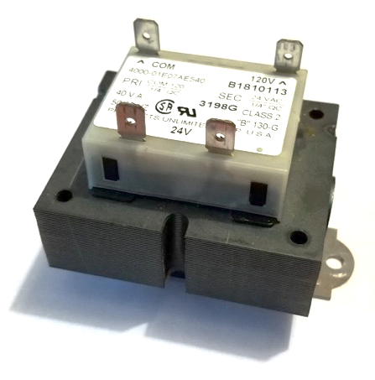
Troubleshooting – The Source
For this IFC, the polarity of the secondary is not an issue. With other IFCs it may be a problem:
Occasionally, the leads on the secondary side of the transformer do not indicate which line is power and which line is common
With most low voltage loads, polarity is not an issue
In the flame sensing and rectification circuit, polarity is required
An improperly constructed transformer could have the polarity of the secondary reversed right out of the box
Notes:
Need to make clear that this section is discussing non-integrated boards and that the secondary voltage could be reversed

Slide 26
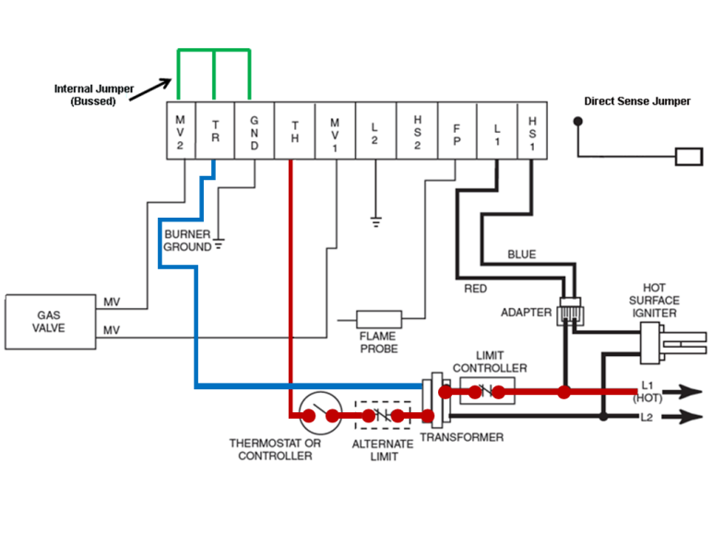
How Do You Check Polarity On The Secondary?
You can’t check the secondary without taking the loads out of the circuit.
How long does it take remove all these wires?
By the way what is this TR and TH terminal on the board?
TH is not thermostat– it is Transformer Hot Leg
TR is not just the transformer–it is the Transformer Return
Notes:
Looking at an older wiring diagram of a non-integrated furnace control board (no control of the blower operation – just the burner operation)

Slide 27
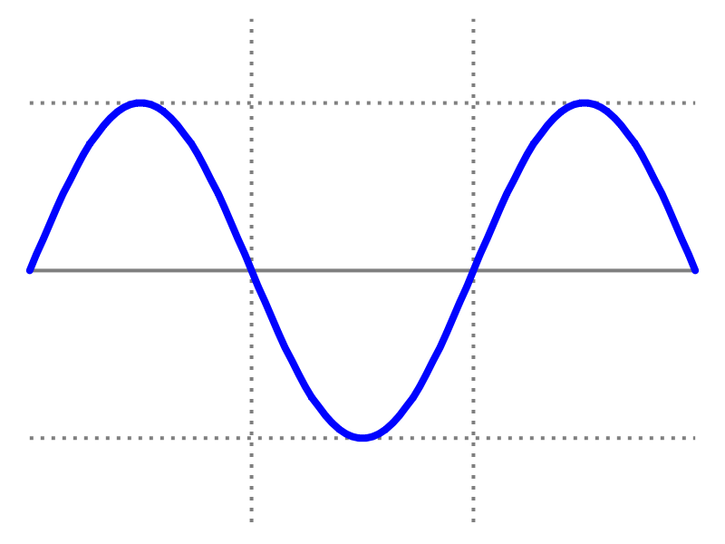
Check the Frequency (Hertz) to Check the Polarity
It is an alternating current that switches its polarity 60 times in a second. It literally goes positive and negative every 1/60th of a second
You don’t need an oscilloscope to verify frequency
+ VAC
0 VAC
Zero Crossover (No Voltage)
- VAC
60 Hertz AC Frequency

Slide 28
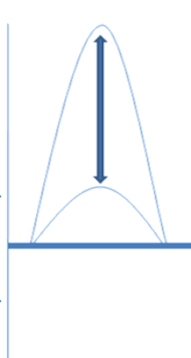
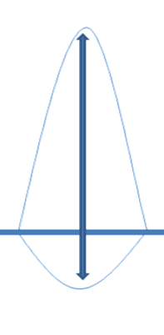
To Check the Secondary You Check the Phasing!
You’ve got 120VAC and 24 VAC in the Furnace. If they are in phase they have the same frequency and go positive and negative in tandem.
If the Primary has the right polarity and it is in phase with the secondary what does that tell you?
In Phase
Out of Phase
+ 120 VAC
+ 24 VAC
O VAC
- 24 VAC

Slide 29
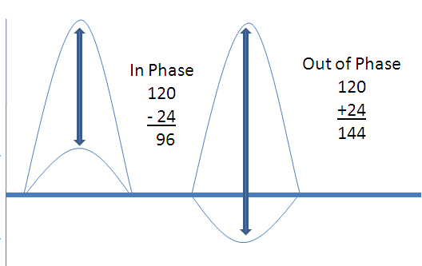
What is it to be “In Phase”
It is for stability for the flame rectification circuit why phasing is a consideration. The control simply measure the difference in the “peak to peak” of the voltages.
A smaller number than 120 VAC indicates correct polarity.
A larger number than 120 VAC indicates incorrect polarity
+ 120 VAC
+ 24 VAC
O VAC
- 24 VAC
Notes:
Be aware that subtracting a negative # is same thing as adding an absolute #

Slide 30
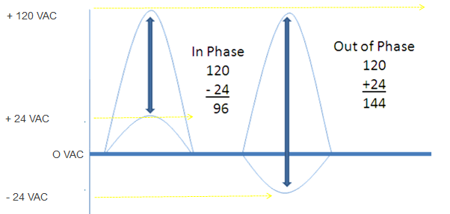
How To Check Polarity On The Secondary
Measure between L1 and TH.
In Phase = Small voltage than 120 VAC
Out of Phase = Bigger voltage than 120 VAC
How do you fix the issue?
Reverse the 24 volt secondary and ensure only the TR lead is grounded

Slide 31
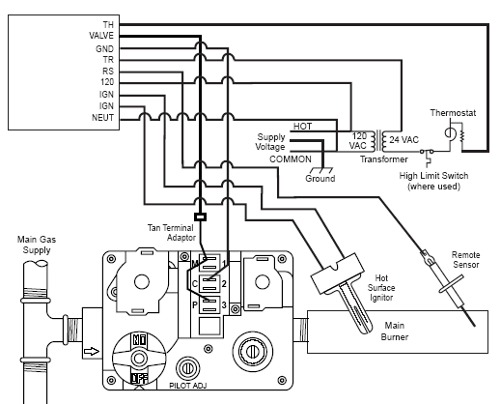
Polarity Issues, Switching the Secondary

Slide 32
Troubleshooting – The Path
About 40VAC @ the IFC output or at the wire of the flame sensor or on the flame sensor
Notes:
If we have proper high voltage to the IFC – proper voltage to the transformer – proper low voltage from the transformer to the IFC. And the current is properly phased:
The next component in the electrical circuit is the path:
From the IFC to the Flame sensor is a wire, voltage can also be checked at the end of the wire or at the metal rod of the flame sensor.
We will check it safely at recessed test pins on the HSI simulator

Slide 33
Put It Into Practice – The Path
IFC Output Voltage:
“Flame Sensor Output on IFC” to “N”
“Flame Sensor Output on IFC” to “G”
What are the readings?
Notes:
Let the participants check the normal readings
Flame Sensor out put to N or G should be around 40VAC
Low voltage should be around 24VAC
Troubleshooting
Put SW9 into the down position
This interrupts high voltage power to the flame sensor.
No High Voltage to the flame sensor
Simulates:
Broken wire to flame sensor (if checking at the wire of the flame sensor)

Slide 34
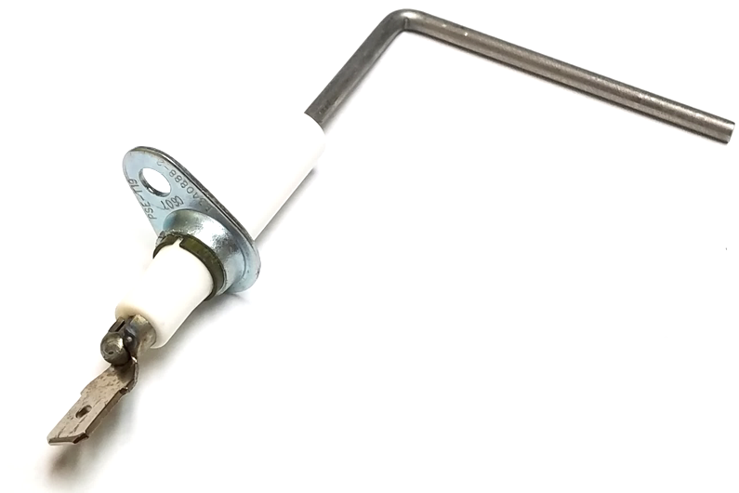
Flame Rod Troubleshooting
The ceramic isolator on the flame rod prevents the voltage in the flame circuit from going direct to ground
A cracked or failed isolator can allow an amount of current to flow to ground
Measure resistance between the flame rod and the mounting bracket
A measurement of OL, or infinite resistance, means the ceramic isolator is intact
Flame rod
Ceramic isolator
Mounting bracket

Slide 35
Troubleshooting – The Load
> 2 uADC for this IFC is a strong flame signal
Notes:
This is the most common area for issues:
The flame (Remember that the flame is also a switch) is not connecting the flame sensor/rod to the burner face
Probably the issue is a dirty/corroded flame sensor/rod and/or burner face

Slide 36
Put It Into Practice – The Load
With a call for heat, note the reading on the display
What is the voltage reading?
Display is in uA DC.
Notes:
Let the participants check the normal readings
In either mode (Live Fire or LED Only)
Make sure that SW14 is in the UP position for strong flame sense reading – above 2 uADC
The two pins on the IFC is where the reading will take place
STRESS!!! White Rodgers IFCs have a unique time saving way to check the flame signal strength:
Instead of having to unhook the flame sensor wire and putting the meter leads in series with the wire that goes to the flame sensor and the flame senor (probably need alligator clips to do this and turn the furnace on)
White Rodgers IFC have 2 pins that you can check the VDC – that converts to uADC in a simple 1:1 ratio, so 2 VDC = 2uADC
Troubleshooting
No flame signal: Move SW14 to the MIDDLE position – the result will be no flame signal and the flame (if in Live Fire mode or the “Burner” LED) will only very briefly be active
Weak flame signal strength: AFTER THE FLAME OR BURNER LED HAS BEEN ESTABLISHED
QUICKLY Move SW14 to the MIDDLE position
The result will be weak flame signal strength and the IFC LED will be a RAPID AMBER Flash

Slide 37
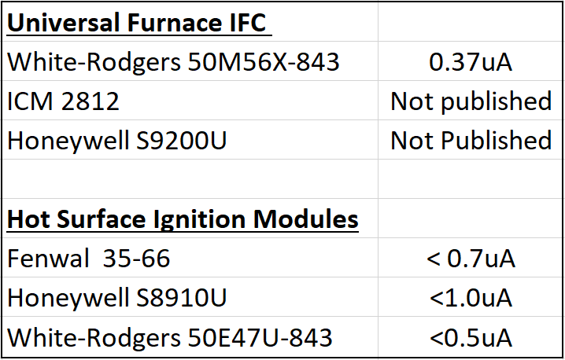
Troubleshooting – The Load
Minimum required current flow required for flame proving depends on the model and manufacturer of the IFC
Voltage supplied to the flame sensing circuit can change the current flow through the circuit
Check the installation/service manual for the furnace or IFC to determine the minimum µA reading for proper flame sensing.
Notes:
The table reinforces the fact that individual models from different manufacturers have a minimum current required for flame detection

Slide 38
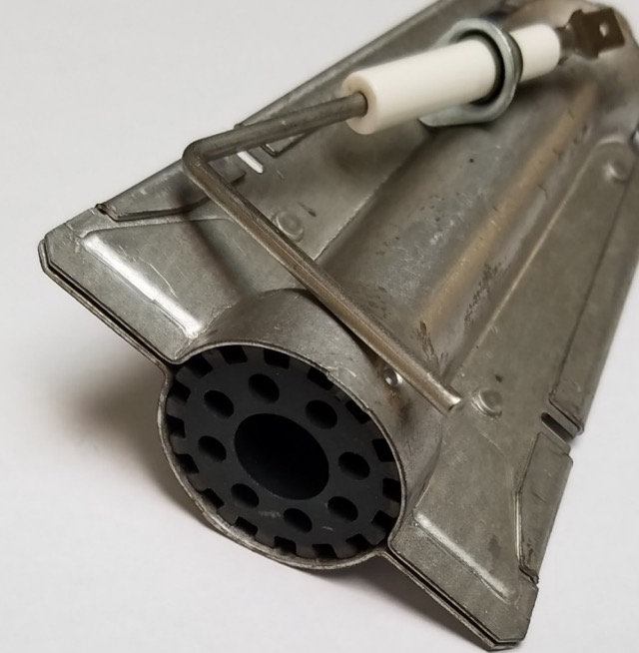
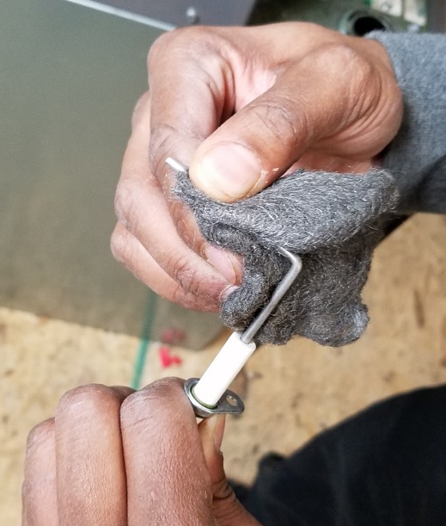
Troubleshooting – The Load
Remember that the flame rectification circuit is an electrical circuit and thus must be continuous with no interruptions in the current flow
The biggest obstacle is a dirty flame sensor and/or burner surface you may not see it but, electrically, it is there
Notes:
This is really the part of the entire flame rectification circuit where most failures will occur
Combustion air that is brought from inside the home is typically more dirty than outside air
Fumes from chemicals used in crafting, bathroom products (beauty, hair, etc.), laundry soaps and softeners, bleach, etc., etc., etc. can all create corrosion when burned in the flame
As well as air conditioning in the summer-time: the heat exchanger metal is cold and there is warm, moist air flowing through the insides of the heat exchanger tubes and burner vestibule

Slide 39
Troubleshooting – The Path
About 40VAC @ the IFC output or at the wire of the flame sensor or on the flame sensor
Be sure that the flame rod is in contact with the flame
Notes:
If we have proper high voltage to the IFC – proper voltage to the transformer – proper low voltage from the transformer to the IFC.
The burner and the flame rod have been cleaned, the flames are proper strength and connecting the flame sensor to the burner.
Then the issue is most likely the rest of the path:
The metal inside the furnace that ultimately provides a path to earth ground:
The screws that hold the burners to the bracket
The screws that hold the bracket to the heat exchanger wall
The screws that hold the furnace panels together until current can reach the equipment ground wire (that is screwed into the metal panel)
Corrosion? Loose screws? Loose connections?
The connections in the wiring for equipment ground that travels through the furnace switch electrical connection box all the way back to the breaker panel/fuse box?
And ultimately the earth ground – next slide

Slide 40
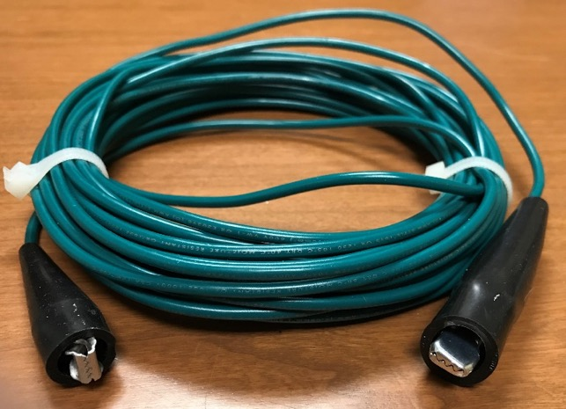
How to Check Equipment Earth Ground
Earth ground can be tested by performing an ohmmeter check with the POWER OFF
Test for continuity (amount of electrical resistance) between an unpainted surface of the sheet metal jacket and the nearest metal water pipe or proven earth ground.
If the ohmmeter indicates more than 1,000 ohms (1k ohm) then the earth ground is suspect.
How to Verify
Using the grounding tool attach the alligator to the breaker box ground strap
Verify with the ohmmeter you have continuity with no resistance (Zero Ohms)
Operate equipment to verify the system is holding in properly.
Upon confirmation of a faulty ground you will need to pull a ground wire from the equipment back to the ground strap on the breaker box.
Here is a picture of a simple tool you can make using 30 feet of 18GA stranded wire, and a couple of alligator clips

Slide 41
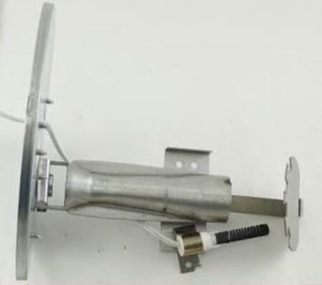
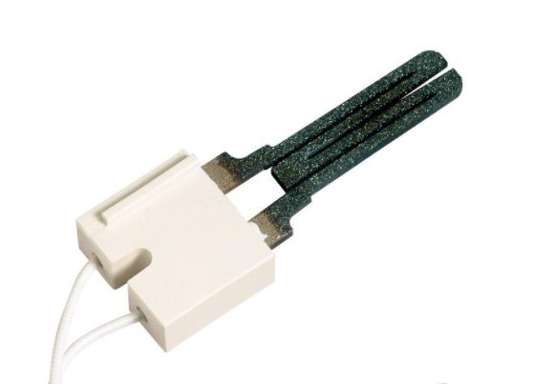
Bonus Information: Direct Flame Sensing
Some flame sensing circuits use the ignitor as a part of the flame sensing circuit
This is called direct flame sensing
They do not use a secondary flame rod (remote)
After the burners ignite, current remains on the HSI and flows through the flame to the burner ground – flame rectification
Notes:
Direct flame sensing is an older technology. It’s not common, but there are still systems out there (mostly manufactured housing furnaces. If the system has a hot surface ignitor but no flame rod, it is a direct sensing system.
Note the burner picture – there is no remote flame sensor/rod.
After the 120 volts is applied to the igniter and just after the gas valve opens, the neutral opens on the board and only high voltage remains on the ignitor.
The ignitor is now the flame sensor

Slide 42
Key Takeaways
A strong flame sense circuit should have:
Proper source voltage
Adequate flame engulfing the flame rod
Complete ground path
Most faults are communicated by the IFC diagnostic LED and can be confirmed with meters
Most common faults can be avoided by performing annual maintenance on the flame rod and burner
For more information on troubleshooting visit us on White Rodgers Education Central https://go.bluevolt.com/whiterodgers/s/?brand=whiterodgers

Slide 43
White-Rodgers Comprehensive Solutions Delivered
Industry Leading Products
Used by more OEM’s
Offering the widest range of Universal HVAC parts
Ease of Installation
Simple, easy to understand instructions
Standard wiring nomenclature
Reliability of Product
Quality control provides reliable products
Affordable
Competitive prices
Supported by Knowledgeable Representatives
Contractor direct phone support
R-5833 (11/23)

